Slide 1
Full Stack Application Development
Securing API
Oauth and OpenID
Oauth
Akshaya Ganesan

Slide 2
OAuth

Slide 3
OAuth
OAuth (Open Authorization) is an open standard for access delegation.
It is commonly used as a way for internet users to grant websites or applications access to their information on other websites.
It specifies a process for resource owners to authorize third-party access to their server resources without providing credentials.
OAuth works over HTTPS and authorizes devices, APIs, servers, and applications with access tokens rather than credentials.

Slide 4
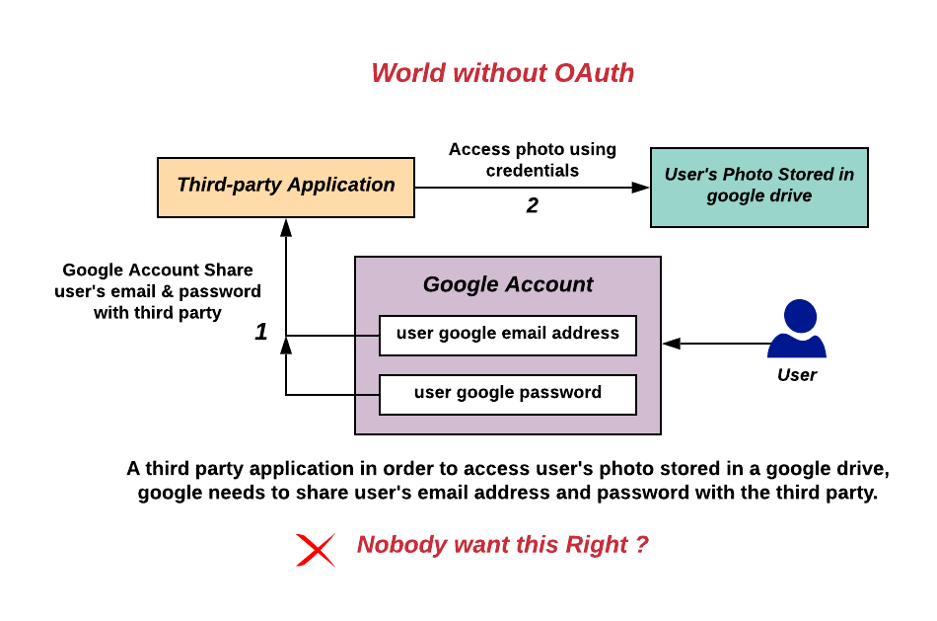
Without OAuth
Image Ref: By Devansvd - Own work, CC BY-SA 4.0, https://commons.wikimedia.org/w/index.php?curid=109591037

Slide 5
OAuth
OAuth is a delegated authorization framework for REST/APIs.
It enables apps to obtain limited access (scopes) to a user’s data without giving away a user’s password.
It decouples authentication from authorization and supports multiple use cases addressing different device capabilities.
It supports server-to-server apps, browser-based apps, mobile/native apps, and consoles/TVs.

Slide 6
OAuth
Analogy: If you have a hotel key card, you can access your room.
How do you get a hotel key card?
You have to do an authentication process at the front desk to get it.
After authenticating and obtaining the key card, you can access the room and resources permitted across the hotel.

Slide 7
OAuth
Similarly ,App requests authorization from User
User authorizes App and delivers proof.
App presents proof of authorization to server to get a Token
Token is restricted to only access what the User authorized for the specific App

Slide 8
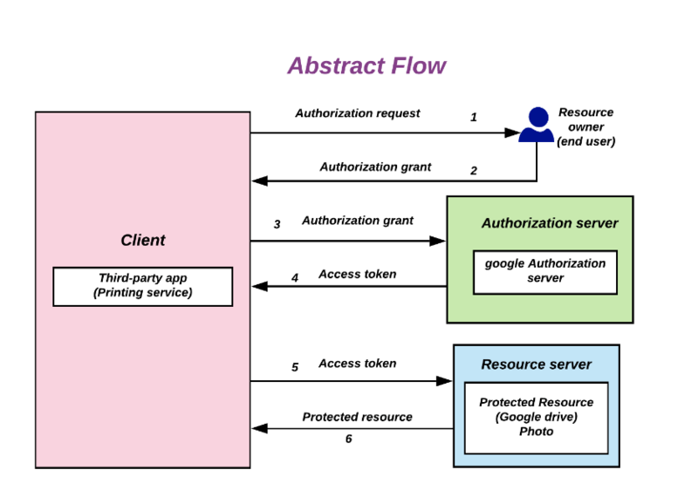
OAuth Flow
Image Reference: By Devansvd - Own work, CC BY-SA 4.0, https://commons.wikimedia.org/w/index.php?curid=109591026

Slide 9
OAuth Central Components
OAuth is built on the following central components:
Scopes and Consent
Actors
Tokens
Flows

Slide 10
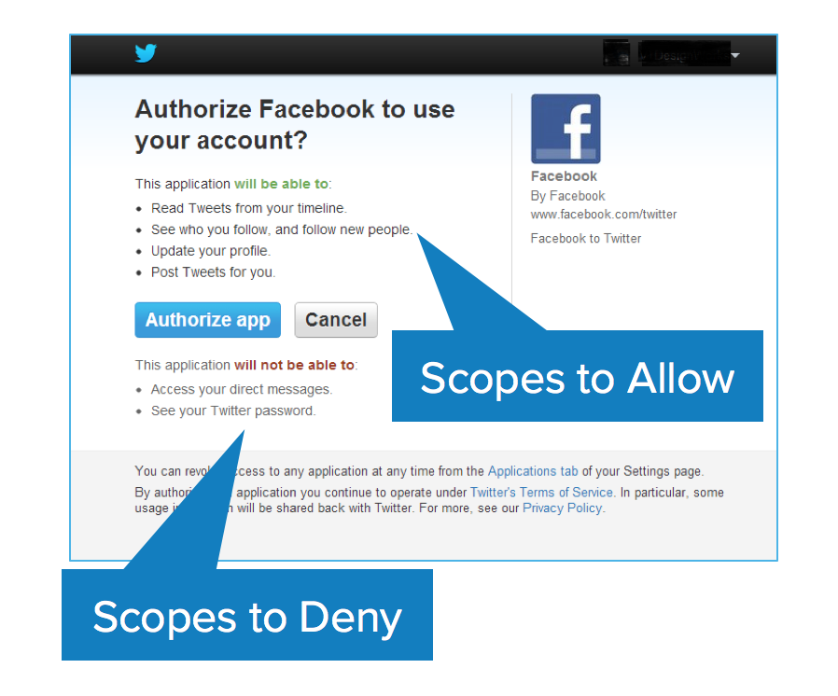
Scopes
Scopes are what you see on the authorization screens when an app requests permissions.
They’re bundles of permissions asked for by the client when requesting a token.
These are coded by the application developer when writing the application.

Slide 11
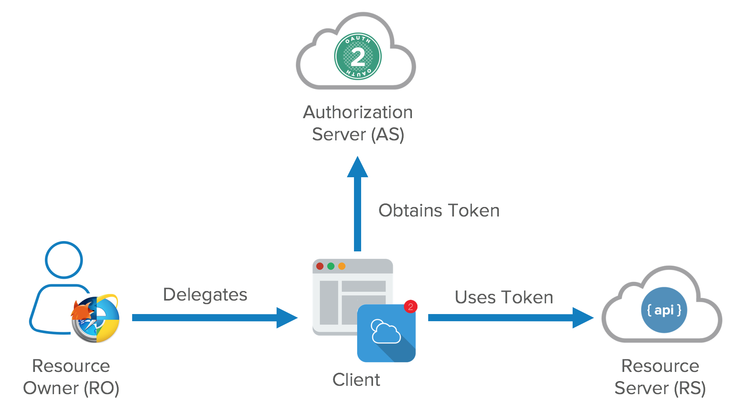
Actors
The actors in OAuth flows are as follows:
Resource Owner: owns the data in the resource server.
Resource Server: The API which stores data the application wants to access
Client: the application that wants to access your data
Authorization Server: The main engine of OAuth
Image Reference:https://developer.okta.com/blog/2017/06/21/what-the-heck-is-oauth

Slide 12
Tokens
Access tokens are the token the client uses to access the Resource Server (API).
They’re meant to be short-lived.
Refresh Tokens can be used to get new tokens
The OAuth spec doesn’t define what a token is
Usually JWT is used
Tokens are retrieved from endpoints on the authorization server.
The two main endpoints are the authorize endpoint and the token endpoint.

Slide 13
Flows
OAuth framework specifies several grant types for different use cases.
OAuth grant types:
Authorization Code
Client Credentials
Implicit Flow
Resource Owner Password Flow

Slide 14

Authorization Code Flow
The gold standard is the Authorization Code Flow, that uses both the front channel and the back channel.
Authorization Server
7
3
8
Resource Server
4
2
5
6
1
APP
9
Front channel
Back channel

Slide 15
Implicit Flow
An access token is returned directly from the authorization request.
It typically does not support refresh tokens.
Since everything happens on the browser, it’s the most vulnerable to security threats.
An SPA is a good example of this flow’s use case.

Slide 16
Client Credentials Flow
For server-to-server scenarios, a Client Credential Flow is used
In this scenario, the client application is a confidential client that’s acting on its own.
It’s a back channel only flow to obtain an access token using the client’s credentials.
It supports shared secrets or assertions as client credentials

Slide 17
Resource Owner Password Flow
It’s a legacy grant type for native username/password apps like desktop applications.
In this flow, you send the client application a username and password and it returns an access token from the Authorization Server.

Slide 18
OAuth

Slide 19
Thank You!

